Slide 1
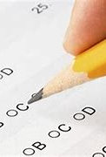
Students Performance In Exams
Using Machine Learning Algorithm
(By means of classification algorithms)
-Developed by:
Kola venkata rohith

Slide 2

Introduction
Machine Learning is the science of getting computers to learn and act like humans do, and improve their learning over time in autonomous fashion.
By feeding them data and information in the form of observations and real-world interactions.
To understand the influence of various factors like economic, personal and social on the students performance.
Every educational system consists of an examination system through which the qualities and abilities of the students are assessed by giving them grades and positons.

Slide 3
Overview
There are many risks related to students performance in exams such inappropriate structure of subjective marks and
individual difference in evaluating the answers, dishonest invigilating staff, wrong marking of scripts etc
Those main factors which affect student ‘s performance in examination mostly prior to fail.
Example- the loan debt of the students has been increased due to the failure of many students in getting graduated on time,Failing of graduating on time costs the government extra expenses.
To avoid these expenses, the government has to ensure that the student graduate on time
Machine Learning is used to predict performance of students and identifying at riskk.

Slide 4
Purpose
To know about the following things each variable is picked such as Parent level of education, race ,lunch,test preparation course etc and has been analysed how they affect the scores.
To improve the students performance in each test
To know the major factors influencing the test scores
Effectiveness of test preparation course
Other inferences
After all ,visualization is the best way to understand from
multiple machine learning algorithms and withdrawing
the conclusions.

Slide 5
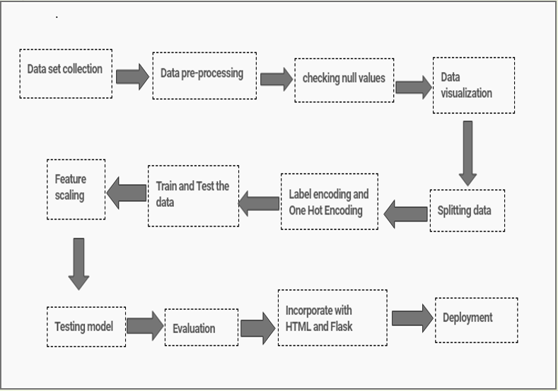
Block diagram

Slide 6
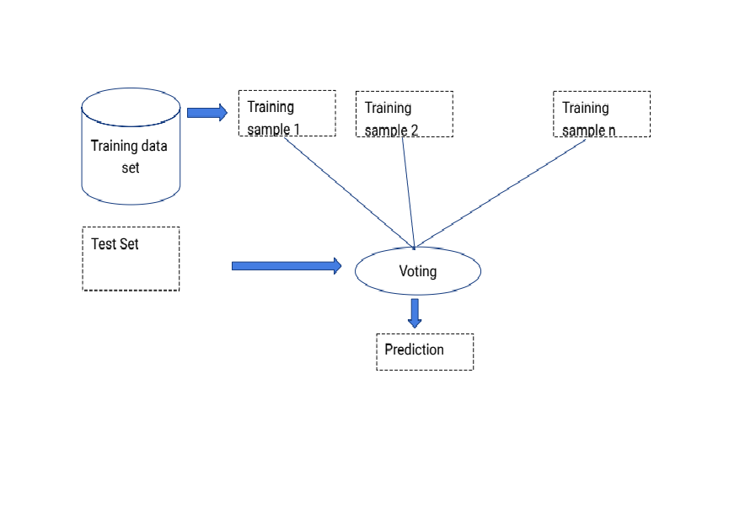

Slide 7
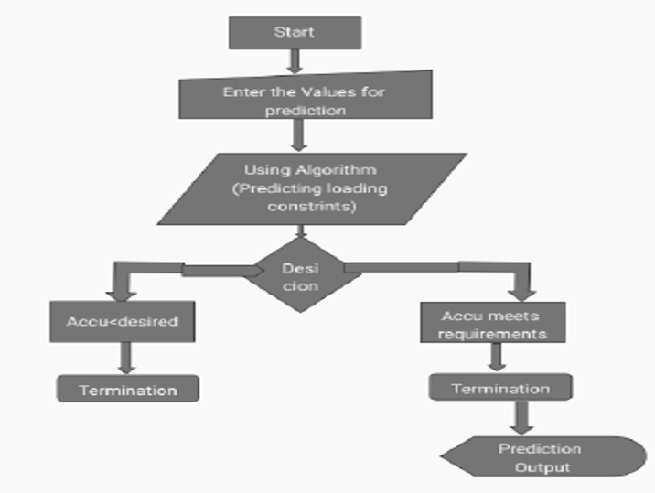
Flow Chart

Slide 8
Advantages and Disadvantages
Advantages:
SVM’s Works well with even unstructured and semi structured data like text, Images and trees.
The kernel trick is real strength of SVM,By this we can solve any complex problem.
SVM models have generalization in practice, the risk of over-fitting is less in SVM. SVMs give better result compared to other models.
Disadvantages:
Choosing a “good” kernel function is not easy.
Long training time for large datasets.
Difficult to understand and interpret the final model, variable weights and individual impact.

Slide 9
Conclusion
The success of machine learning in predicting student performance relies on the good use of the data and machine learning algorithms.
In this project,the SVM algorithm is adopted to build a UI model for predicting the grades. And the results are compared with other algorithm that is logistic,decision tree,knn others.
This research study explored the relationships of student grades from the examinations such as math score,reading score, writing score.

Slide 10


